Slide 1


4DMVP Update
Nathan Collins,
Dr. Ella Atkins
Virginia Tech, Blacksburg, VA
Joseph Kim, Giovanni Franzini
Collins Aerospace
November 21, 2024

Slide 2
Problem Overview
Problem Statement: Develop an algorithm for arbitrating free airspace among autonomous vehicles without the use of corridors and assess its effectiveness
Major Questions:
How do we leverage the strengths of autonomous vehicles with almost no limits on traversal capability?
How do we optimize traffic?
How do we effectively simulate real environments?
How much airspace does a vehicle need to reserve, and when?
How effective are basic graph search algorithms?
How do we statistically characterize the algorithm’s effectiveness?
Work so far:
Discrete State-Space planning algorithm implemented
Analytical state-space discretized and searchable
Algorithm efficiency improved significantly
5-10x faster than last month
Algorithm still loosely based on A*
Major changes from a standard A* approach
Geofencing strategy used to ensure safety without damaging optimality
Two-tier geofencing strategy implemented
Notes:
To decide which threshold we are going to use, GRS antenna analysis was needed.
Drawing on left is the concept sketch of GRS beam shown on last presentation, and the concept will be still considered same.
Table below shows the parameters of GRS. Given table had only 4 rows from High Altitude Relay (HAR) to Low Altitude (LA).
However, our interest is below 3,500ft, especially at 3,500ft and 400ft which is marked as red square.
So I added the row written in blue with estimation of antenna gain and SV radius.
(ask question)

Slide 3
Overview of This Month’s Work
Proposed ConOps Implemented
Path planning algorithm requires no knowledge of previous paths or vehicles*
Full occupancy data exchange accomplished using occupancy tensor
Occupancy Tensor Data Structure Improved
Represents a time-space’s occupancy in efficient format.
Still an extra voxel condition available for use.
4D Discrete Search → State Space Semi-Discrete Search
Search space is now a limited vehicle state-space
Neighboring nodes are determined using kinematic feasibility, then trimmed using the occupancy tensor
Dynamic Geofencing → Two-Tier Geofencing
Planning algorithm performs dynamic checks against occupancy tensor
Vehicle geofences now do not collide with each other.
Writing/overwriting of data in the occupancy tensor is handled
Various backend improvements to code structure
Speed of algorithm vastly improved
Paths to do not fail to solve
Visualization & Statistics
Notes:
To decide which threshold we are going to use, GRS antenna analysis was needed.
Drawing on left is the concept sketch of GRS beam shown on last presentation, and the concept will be still considered same.
Table below shows the parameters of GRS. Given table had only 4 rows from High Altitude Relay (HAR) to Low Altitude (LA).
However, our interest is below 3,500ft, especially at 3,500ft and 400ft which is marked as red square.
So I added the row written in blue with estimation of antenna gain and SV radius.
(ask question)

Slide 4
Updated ConOps
Updated ConOps
Paths can be pre-planned or not pre-planned
Planning paths far into the future comes with the cost of increasing the size of the occupancy tensor, sometimes significantly.
A vehicle wants to travel from one location to another
ie. somebody requests a ride
It either plans the path using the current map, or sends a request to a central computer
The path is planned using the current occupancy map
The path planner returns a series of waypoints to the vehicle to be fed into guidance algorithms
The path planner updates the occupancy map with its own path
Transmits this to all other vehicles
Separately, at each epoch, the first epoch is truncated to avoid unnecessarily tracking history
}
other agents
locked out
}
unlocked
Notes:
In this slide, 3D figures are added based on the parameters on table, to assist understanding of GRS beam shape.
On 2D graphs, beam seems to spread in high angle, but when seeing 3D graph, you can see the spread angle is low as 7 degree.
As I mentioned before, even though we have parameters up to 120,000ft, our interest stays on altitude below 3,500ft.
Moreover, considering the concept sketch, I assumed the beam will spread in linear line up to 3,500ft from the ground shown in the graph on bottom right.

Slide 5
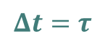


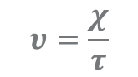
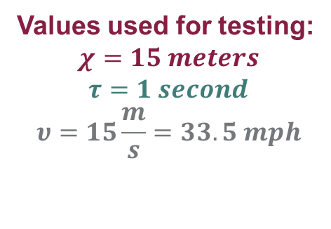
Occupancy Tensor Data Structure
Define an occupancy tensor ζ at i epochs from reference time/start of day as the following
Where the ith epoch is referenced from the start of day
Can be represented as a UTC time, for example
Map defined based on spatial and temporal epochs
Spatial Epoch χ = Length/Width/Height of each voxel
Temporal Epoch τ = Timestep between voxel time indices
Resultant characteristic velocity v = χ/τ useful as well
Vehicle performance defined in these canonical units
$ζ_{i}\left(x,y,z,t\right):\left\{\left[L,0,0,0\right]×\left[0,W,0,0\right]×\left[0,0,H,0\right]×\left[0,0,0,{tf}_{i}\right]→φ\right\}$
$$x,y,z,t∈ℤ$$
$$φ\left(x,y,z,t\right)=\left\{\begin{aligned}0, free \\ &×, unknown \\ 1, occupied\end{aligned}\right.$$
$$υ=\frac{χ}{τ}$$
Values used for testing:
$$χ=15 meters$$
$$τ=1 second$$
$$υ=15\frac{m}{s}=33.5 mph$$
$$Δt=τ$$
$$χ$$
$$χ$$
Notes:
In this slide, 3D figures are added based on the parameters on table, to assist understanding of GRS beam shape.
On 2D graphs, beam seems to spread in high angle, but when seeing 3D graph, you can see the spread angle is low as 7 degree.
As I mentioned before, even though we have parameters up to 120,000ft, our interest stays on altitude below 3,500ft.
Moreover, considering the concept sketch, I assumed the beam will spread in linear line up to 3,500ft from the ground shown in the graph on bottom right.

Slide 6
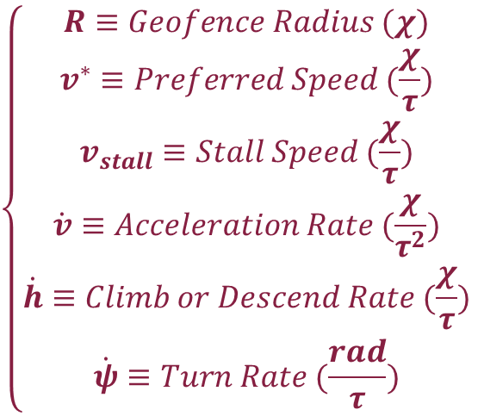
Vehicle Performance Profile
Vehicle Performance Profiles defined as:
Profile affects Geofencing:
$$\left\{\begin{aligned}R≡Geofence Radius (χ) \\ v^{∗}≡Preferred Speed (\frac{χ}{τ}) \\ v_{stall}≡Stall Speed (\frac{χ}{τ}) \\ \dot{v}≡Acceleration Rate (\frac{χ}{τ^{2}}) \\ \dot{h}≡Climb or Descend Rate (\frac{χ}{τ}) \\ \dot{ψ}≡Turn Rate (\frac{rad}{τ})\end{aligned}\right.$$
2R
Geofence (potentially occupied)
Keep-out-zone (close enough to warrant detailed check)
R
Vehicle performance profile is an important input to the search algorithm
Behavior with different vehicle profiles occupying the same map not yet characterized
This profile controls how the search space is discretized during the path planning, but has no effect on the occupancy tensor
Notes:
In this slide, 3D figures are added based on the parameters on table, to assist understanding of GRS beam shape.
On 2D graphs, beam seems to spread in high angle, but when seeing 3D graph, you can see the spread angle is low as 7 degree.
As I mentioned before, even though we have parameters up to 120,000ft, our interest stays on altitude below 3,500ft.
Moreover, considering the concept sketch, I assumed the beam will spread in linear line up to 3,500ft from the ground shown in the graph on bottom right.

Slide 7

Path Planning Algorithm
Hybrid A* Algorithm
State Space discretized:
State “adjacency” calculated using distinct maneuvers
Cruise, Climb/Descend, Accelerate/Deaccelerate, Turn, Delay*
Heuristic h is cartesian distance to the goal
Path cost g is designed to measure energy expenditure
Time component represents cost of staying in the air
Velocity component represents cost of deviation from ideal speed for aircraft
Tunable Parameters
w: weight of time cost vs. velocity deviation cost
GM: Greediness multiplier on heuristic encourages faster paths over optimal paths
$${\overset{⃑}{x}}_{i}=\left\langle x | y | z | v | ψ | t\right\rangle , g_{i},h_{i}$$
$${\overset{⃑}{x}}_{i+1}={\overset{⃑}{x}}_{i}+\vec{f}\left(maneuver type\right)$$
$$g_{i+1}=g_{i}+w∗\left(t_{i+1}−t_{i}\right)+\left(1−w\right)(v_{i+1}−v^{∗})$$
$$h_{i}=GM∗hypot({\overset{⃑}{x}}_{i},{\overset{⃑}{x}}_{f})$$
Notes:
In this slide, 3D figures are added based on the parameters on table, to assist understanding of GRS beam shape.
On 2D graphs, beam seems to spread in high angle, but when seeing 3D graph, you can see the spread angle is low as 7 degree.
As I mentioned before, even though we have parameters up to 120,000ft, our interest stays on altitude below 3,500ft.
Moreover, considering the concept sketch, I assumed the beam will spread in linear line up to 3,500ft from the ground shown in the graph on bottom right.

Slide 8
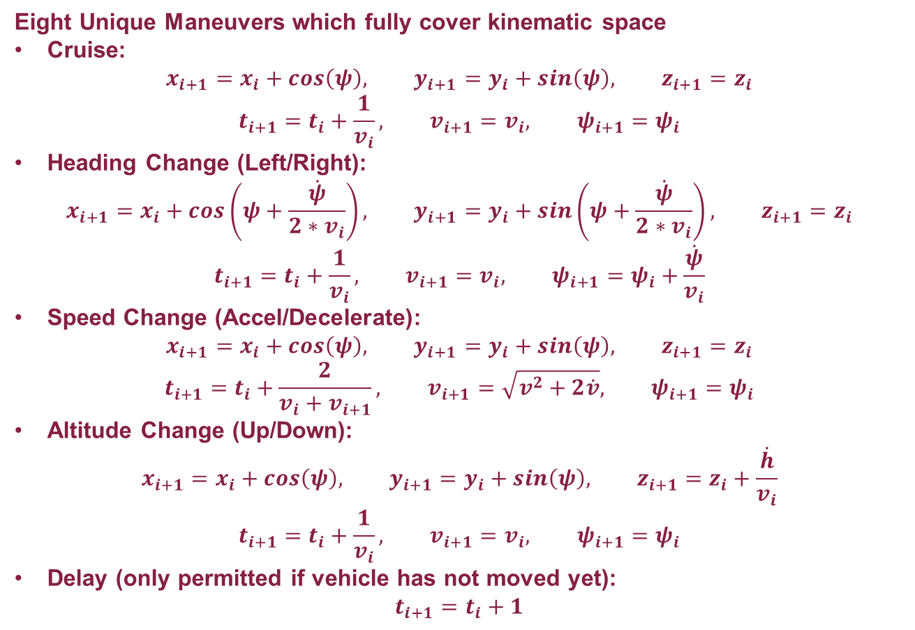
Distinct Maneuver Specifications
Eight Unique Maneuvers which fully cover kinematic space
Cruise:
$$x_{i+1}=x_{i}+cos\left(ψ\right), y_{i+1}=y_{i}+sin\left(ψ\right), z_{i+1}=z_{i}$$
$$t_{i+1}=t_{i}+\frac{1}{v_{i}}, v_{i+1}=v_{i}, ψ_{i+1}=ψ_{i}$$
Heading Change (Left/Right):
$$x_{i+1}=x_{i}+cos\left(ψ+\frac{\dot{ψ}}{2∗v_{i}}\right), y_{i+1}=y_{i}+sin\left(ψ+\frac{\dot{ψ}}{2∗v_{i}}\right), z_{i+1}=z_{i}$$
$$t_{i+1}=t_{i}+\frac{1}{v_{i}}, v_{i+1}=v_{i}, ψ_{i+1}=ψ_{i}+\frac{\dot{ψ}}{v_{i}}$$
Speed Change (Accel/Decelerate):
$$x_{i+1}=x_{i}+cos\left(ψ\right), y_{i+1}=y_{i}+sin\left(ψ\right), z_{i+1}=z_{i}$$
$$t_{i+1}=t_{i}+\frac{2}{v_{i}+v_{i+1}}, v_{i+1}=\sqrt{v^{2}+2\dot{v}}, ψ_{i+1}=ψ_{i}$$
Altitude Change (Up/Down):
$$x_{i+1}=x_{i}+cos\left(ψ\right), y_{i+1}=y_{i}+sin\left(ψ\right), z_{i+1}=z_{i}+\frac{\dot{h}}{v_{i}}$$
$$t_{i+1}=t_{i}+\frac{1}{v_{i}}, v_{i+1}=v_{i}, ψ_{i+1}=ψ_{i}$$
Delay (only permitted if vehicle has not moved yet):
$$t_{i+1}=t_{i}+1$$
Notes:
In this slide, 3D figures are added based on the parameters on table, to assist understanding of GRS beam shape.
On 2D graphs, beam seems to spread in high angle, but when seeing 3D graph, you can see the spread angle is low as 7 degree.
As I mentioned before, even though we have parameters up to 120,000ft, our interest stays on altitude below 3,500ft.
Moreover, considering the concept sketch, I assumed the beam will spread in linear line up to 3,500ft from the ground shown in the graph on bottom right.

Slide 9

Geofencing Strategy
Path planning algorithm efficiently trims possible neighbor states using occupancy map
Recall the map is discretized – these are actually approximated as boxes
Keep-out zones may overlap with geofences, but geofences may not overlap
Behavior:
0: Area is free
1: Area is occupied by another vehicle
2: Area is close enough to another vehicle to trigger a detailed space check
A space check forces the algorithm to check the entire range of the geofence that would be placed at this location, to determine if any geofence overlap would occur.
$$φ\left(x,y,z,t\right)=\left\{\begin{aligned}0, free \\ &×, unknown \\ 1, occupied\end{aligned}\right.$$
not permissible
permissible
Keep-out-zone (close enough to warrant detailed check)
Geofence (potentially occupied)
Notes:
In this slide, 3D figures are added based on the parameters on table, to assist understanding of GRS beam shape.
On 2D graphs, beam seems to spread in high angle, but when seeing 3D graph, you can see the spread angle is low as 7 degree.
As I mentioned before, even though we have parameters up to 120,000ft, our interest stays on altitude below 3,500ft.
Moreover, considering the concept sketch, I assumed the beam will spread in linear line up to 3,500ft from the ground shown in the graph on bottom right.

Slide 10
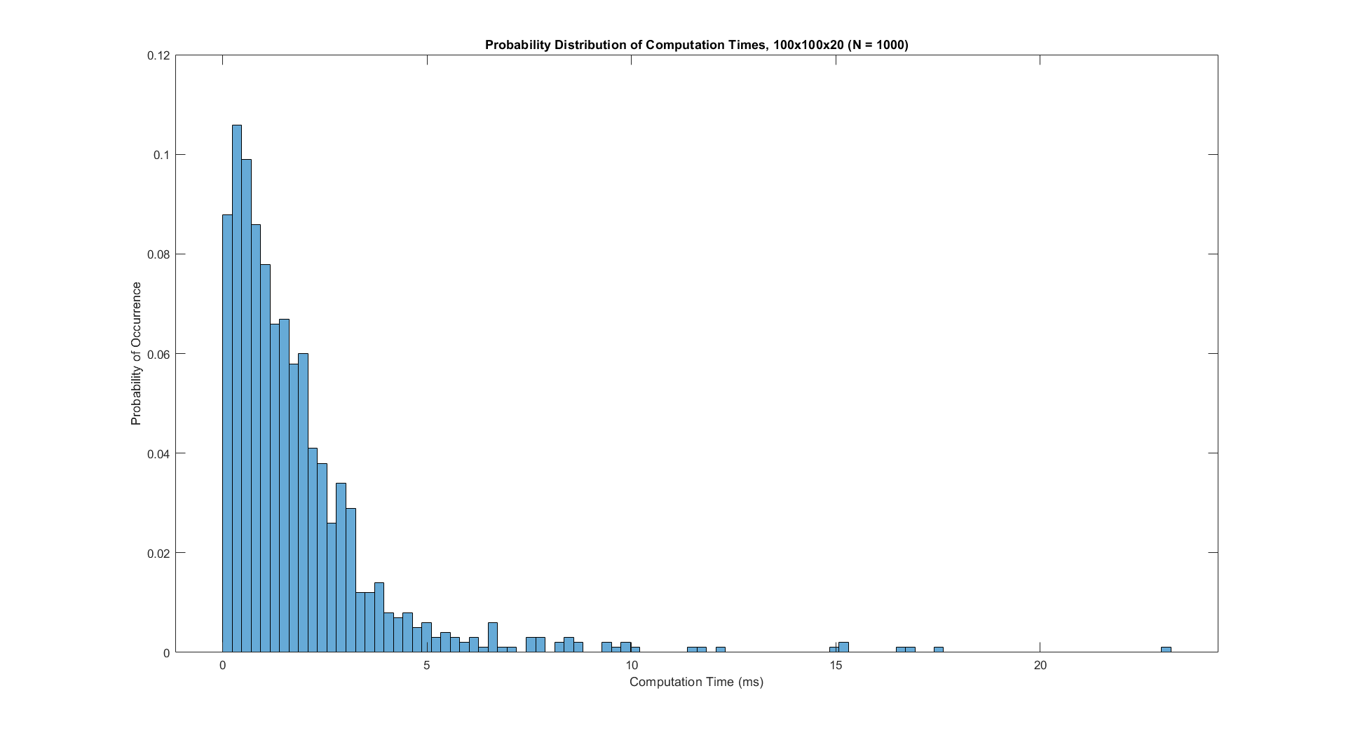
Efficiency Updates
A number of background changes have made the algorithm significantly more efficient
Worst case solve times for ~1mile by ~1mile map < 30ms**
Overview of changes:
Search open list implemented as MinHeap → Retrieval from algorithm’s biggest list in O(log(n)).
Detailed space checks occur infrequently, significantly decreasing computation count.
Closed list is scanned in linear time, which could be improved
1500x1500x300m Airspace
Mean = 1.85ms
Std. Deviation = 2.1423
** for algorithm variant where solutions are rejected if they are forced to wait
Notes:
In this slide, 3D figures are added based on the parameters on table, to assist understanding of GRS beam shape.
On 2D graphs, beam seems to spread in high angle, but when seeing 3D graph, you can see the spread angle is low as 7 degree.
As I mentioned before, even though we have parameters up to 120,000ft, our interest stays on altitude below 3,500ft.
Moreover, considering the concept sketch, I assumed the beam will spread in linear line up to 3,500ft from the ground shown in the graph on bottom right.

Slide 11
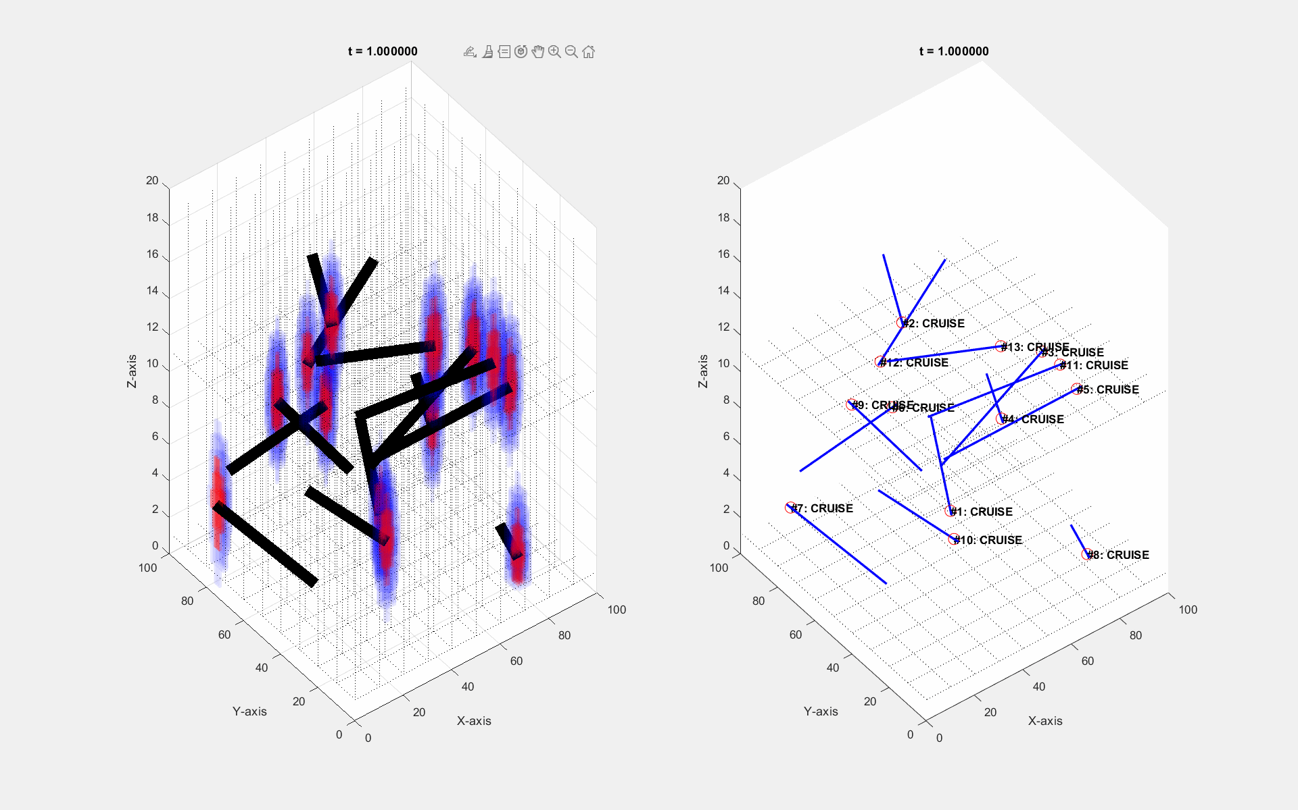
Occupancy Tensor Data Structure - Visualization
This example shows high capacity
1500m by 1500m by 300m
Notes:
In this slide, 3D figures are added based on the parameters on table, to assist understanding of GRS beam shape.
On 2D graphs, beam seems to spread in high angle, but when seeing 3D graph, you can see the spread angle is low as 7 degree.
As I mentioned before, even though we have parameters up to 120,000ft, our interest stays on altitude below 3,500ft.
Moreover, considering the concept sketch, I assumed the beam will spread in linear line up to 3,500ft from the ground shown in the graph on bottom right.

Slide 12
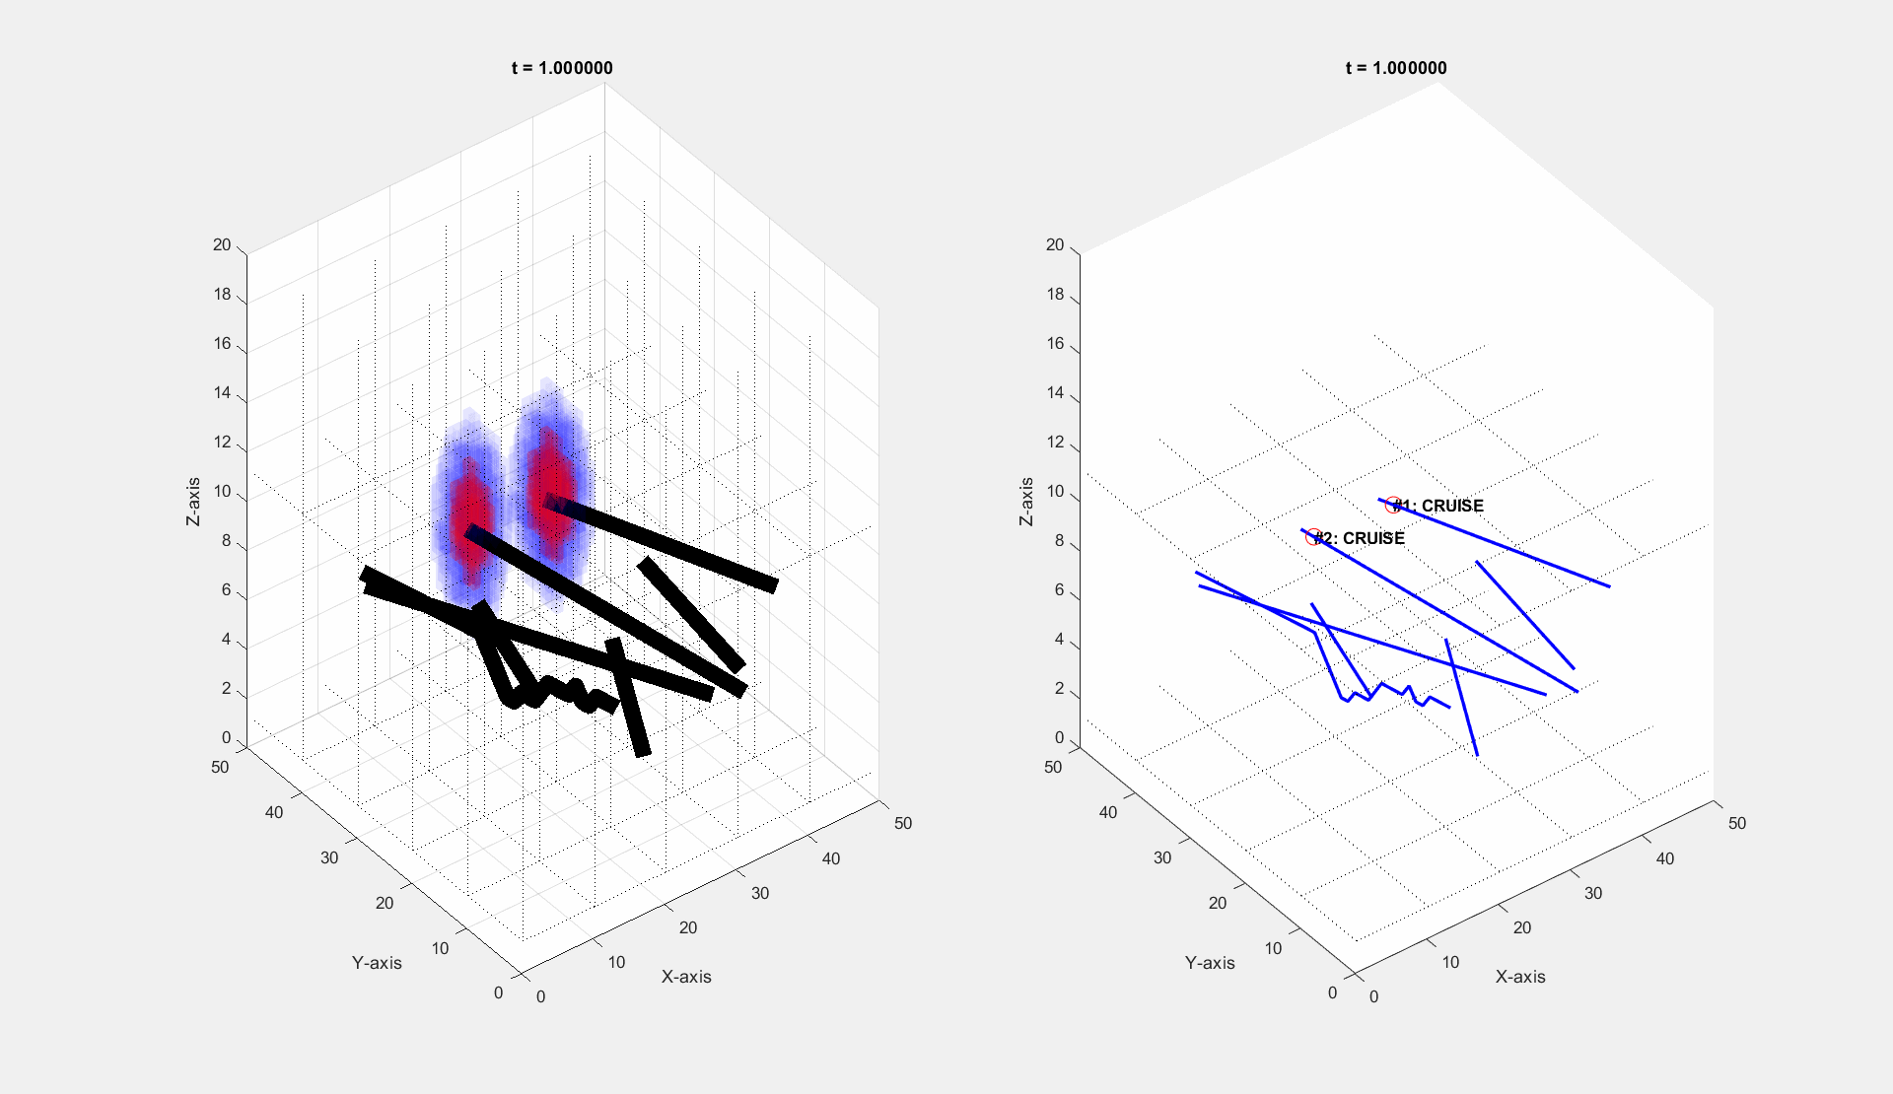
Occupancy Tensor Data Structure - Visualization
This example shows the ability to navigate around other vehicles
1500m by 1500m by 300m
Notes:
In this slide, 3D figures are added based on the parameters on table, to assist understanding of GRS beam shape.
On 2D graphs, beam seems to spread in high angle, but when seeing 3D graph, you can see the spread angle is low as 7 degree.
As I mentioned before, even though we have parameters up to 120,000ft, our interest stays on altitude below 3,500ft.
Moreover, considering the concept sketch, I assumed the beam will spread in linear line up to 3,500ft from the ground shown in the graph on bottom right.

Slide 13
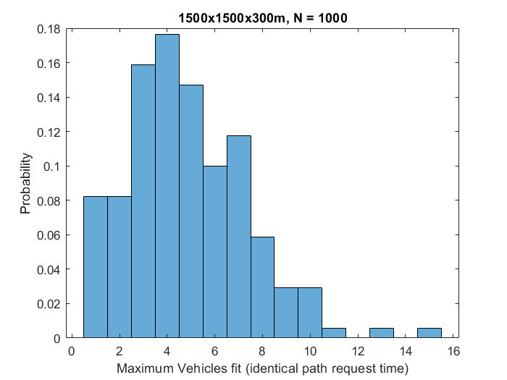
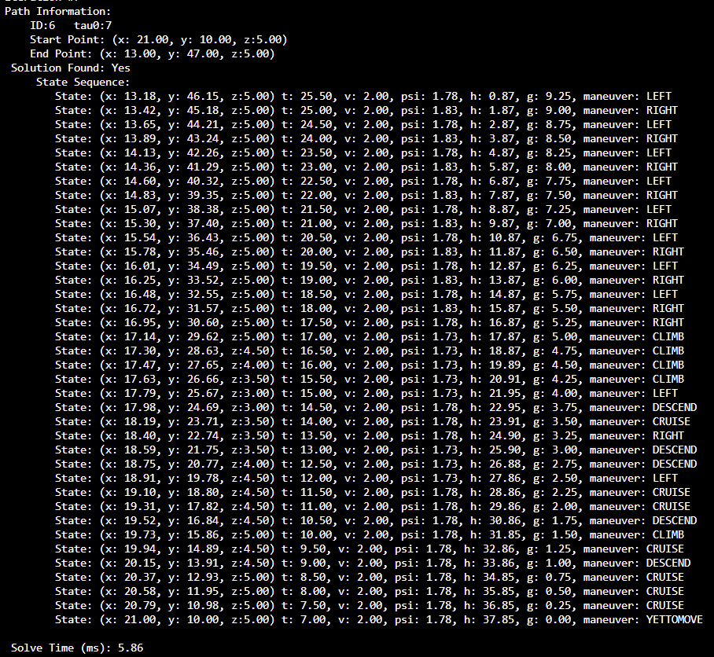
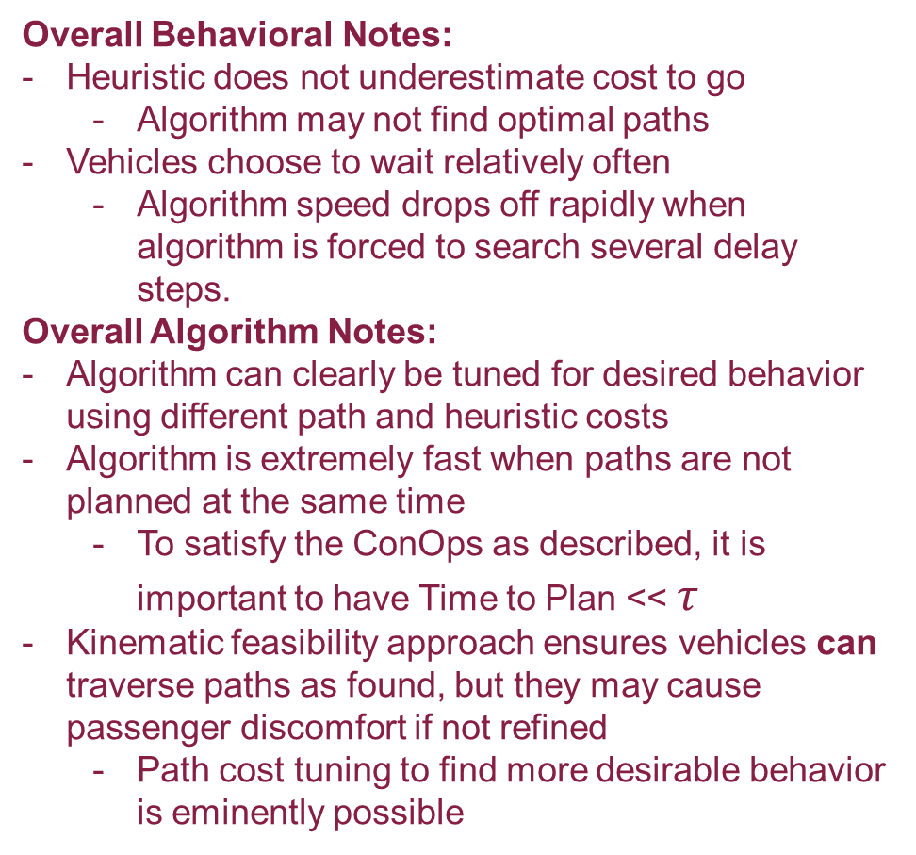
Path Planning Algorithm Results
Overall Behavioral Notes:
Heuristic does not underestimate cost to go
Algorithm may not find optimal paths
Vehicles choose to wait relatively often
Algorithm speed drops off rapidly when algorithm is forced to search several delay steps.
Overall Algorithm Notes:
Algorithm can clearly be tuned for desired behavior using different path and heuristic costs
Algorithm is extremely fast when paths are not planned at the same time
To satisfy the ConOps as described, it is important to have Time to Plan << $τ$
Kinematic feasibility approach ensures vehicles can traverse paths as found, but they may cause passenger discomfort if not refined
Path cost tuning to find more desirable behavior is eminently possible
Notes:
In this slide, 3D figures are added based on the parameters on table, to assist understanding of GRS beam shape.
On 2D graphs, beam seems to spread in high angle, but when seeing 3D graph, you can see the spread angle is low as 7 degree.
As I mentioned before, even though we have parameters up to 120,000ft, our interest stays on altitude below 3,500ft.
Moreover, considering the concept sketch, I assumed the beam will spread in linear line up to 3,500ft from the ground shown in the graph on bottom right.

Slide 14
Future Work – Before December
Improvement of efficiency of algorithm
Closed-List scanning could be more efficient
Modification of heuristic or paths costs
Different formulations could lead to different behaviors
Attempt to tune algorithm to make paths smoother
Attempt to tune algorithm for other desired behavior
Parameter study of weights to evaluate effects on algorithm behavior
Introduce Other Vehicles with Different Performance Profiles
Evaluate performance of algorithm when different types of vehicles are present
Higher volume statistical characterization
Performing higher count test runs, or running the algorithm on an embedded system
Simulate much large spaces
Possibly reintroduce obstacles
Simultaneous Vehicle Path Planning
Modification of vehicle state-space to include multiple vehicles planning simultaneously
Notes:
In this slide, 3D figures are added based on the parameters on table, to assist understanding of GRS beam shape.
On 2D graphs, beam seems to spread in high angle, but when seeing 3D graph, you can see the spread angle is low as 7 degree.
As I mentioned before, even though we have parameters up to 120,000ft, our interest stays on altitude below 3,500ft.
Moreover, considering the concept sketch, I assumed the beam will spread in linear line up to 3,500ft from the ground shown in the graph on bottom right.

Slide 15
Future Work – Long Term
Post-Planning Path Optimization
Use of analytical algorithms to refine paths after discrete-search planning
Lessens requirements on discrete algorithm to produce smooth paths
Approaches could include: RRT*, Optimal Control, Potential Methods.
Physical testing using vehicles
Attempt to test algorithm using multicopters configured to behave like fixed-wing vehicles
Expansion beyond the enroute problem
Incorporate takeoff/hover/etc. dynamics
Notes:
In this slide, 3D figures are added based on the parameters on table, to assist understanding of GRS beam shape.
On 2D graphs, beam seems to spread in high angle, but when seeing 3D graph, you can see the spread angle is low as 7 degree.
As I mentioned before, even though we have parameters up to 120,000ft, our interest stays on altitude below 3,500ft.
Moreover, considering the concept sketch, I assumed the beam will spread in linear line up to 3,500ft from the ground shown in the graph on bottom right.

